Slide 1



EagleSat 2: Design Development
Lauren Barthenheier
Dr. Gary Yale, Embry-Riddle Aeronautical University
Arizona Space Grant Consortium Symposium
April 14, 2018

Slide 2
Outline
Background
Payload Development Testing
  Procedures
  Testing Results and Conclusions
Further Testing

Slide 3
Background: Design Requirements
Fly two payloads
  Charged particle detector
    Catalog and record cosmic rays
  Memory degradation experiment (MDE)
    Test bit-flip corruption rates for commercially available RAM

Slide 4
Background: MDE Mission
Detect bit flipping and memory degradation caused by solar radiation
Commercially available, consumer grade memory
  Flash
  SRAM – Static Random Access Memory (RAM)
  FRAM – Ferroelectric RAM
  MRAM – Magnetic RAM
  EEPROM – Electrically Erasable Programmable Read-Only Memory

Slide 5
Background: MDE Main Algorithm

Slide 6
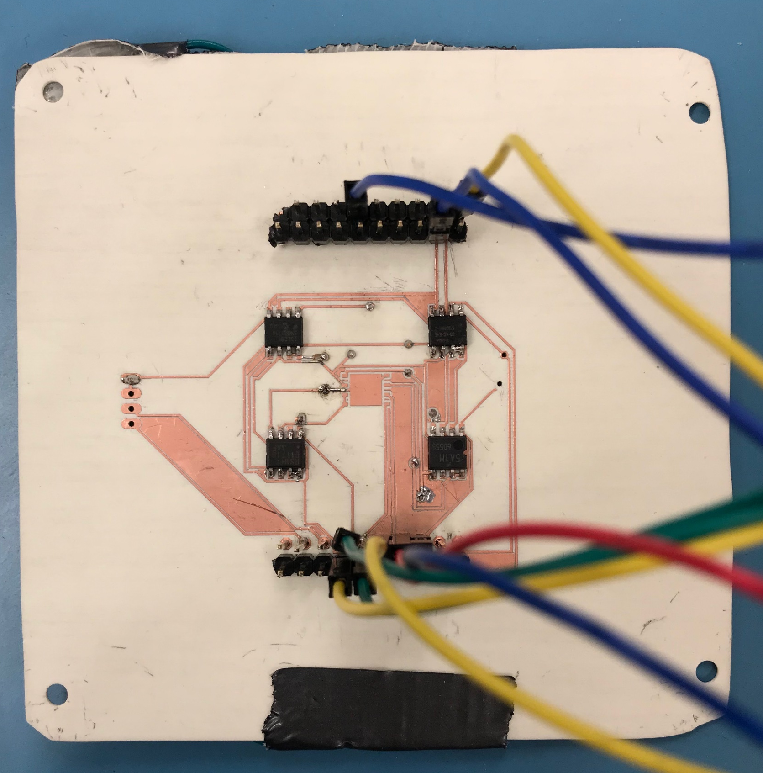
Plugs-In Test
Purpose:
  Ensure MDE runs with constant power and data for at least 30 minutes
  Demonstrate MDE memory responds to all input commands and finds all the correct pre-seeded errors

Slide 7
Pass / Fail Criteria
Pass/Fail | Pass Criteria | Fail Criteria
The MDE memory responds to all the command in accordance with the datasheets and timing. * If this criteria is meet, the test passes for all subsequent criteria | Responds to the commands | Does not respond to the commands
Find the correct errors. | Finds the correct number of errors | Does not find the correct number of errors

Slide 8
Procedures
Ground payload board to static mat
Connect circuit board to power and TM4C LaunchPad
Connect TM4C LaunchPad to computer via Putty software
Press “i” key → Begin error checking for one, 15 minute cycle
Remove pre-seeded error → Repeat step 4 for 10 seconds

Slide 9
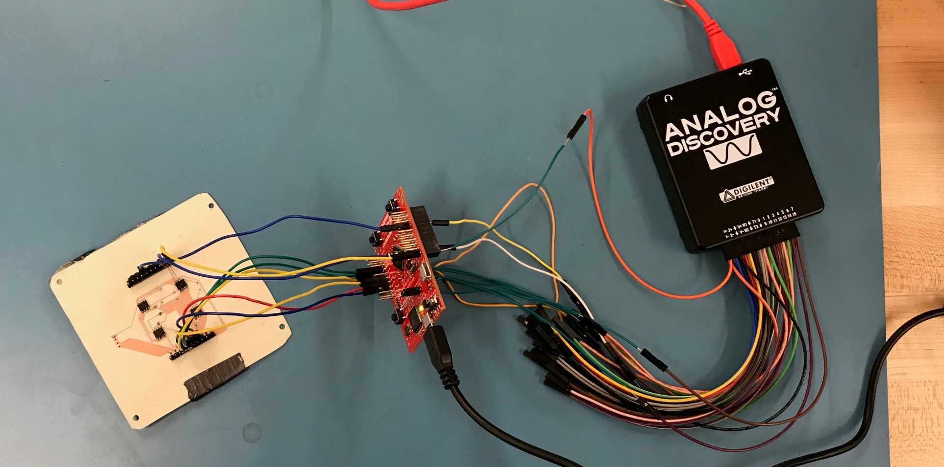
Plugs-In Test Set-Up
Static mat
Power Supply
MDE Board
TM4C

Slide 10
Results
Auto mode, 15 minute delay, seeded errors.
AUTO MODE. Hit M to exit.
Timer wakeup. Checking for errors...
Printing errors...
Error: 1048584
Error: 1048585
Error: 1048587
Error: 1491128
Error: 1491130
Error: 1491131
Error: 1491133
Auto mode, 10 second delay, no seeded errors.
AUTO MODE. Hit M to exit.
Timer wakeup. Checking for errors...
Printing errors...
Sequence written, beginning next cycle.
Timer wakeup. Checking for errors...
Printing errors...
Pre-Seeded Errors
Successfully found 75 pre-seeded errors
No Seeded Errors
Successfully found 0 errors

Slide 11
Results
Pass/Fail | Pass Criteria | Fail Criteria
The MDE memory responds to all the command in accordance with the datasheets and timing. * If this criteria is meet, the test passes for all subsequent criteria | Responds to the commands | Does not respond to the commands
Find the correct errors. | Finds the correct number of errors | Does not find the correct number of errors

Slide 12
Further Development Test
Plugs-In Test for charged particle detector
Plugs-Out Test for charged particle detector and MDE
High altitude balloon for charged particle detector and MDE

Slide 13
Acknowledgements
Dr. Gary Yale, Embry-Riddle Aeronautical University
TeamXC, NASA Jet Propulsion Laboratory
Travis Imken, NASA Jest Propulsion Laboratory

Slide 14
Thank You

